Slide 1
Neural network in python

Slide 2
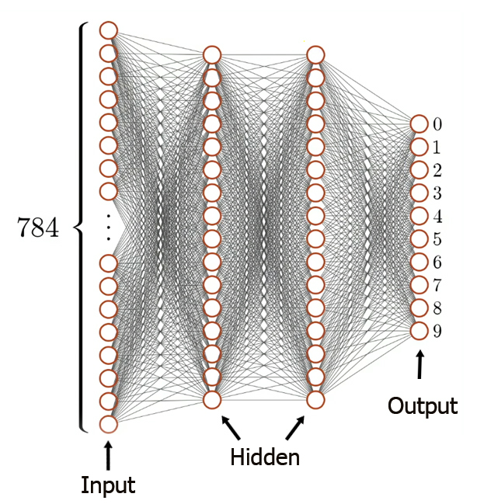
Neural network
The classical representation.
Complex.
Non-linear.

Slide 3
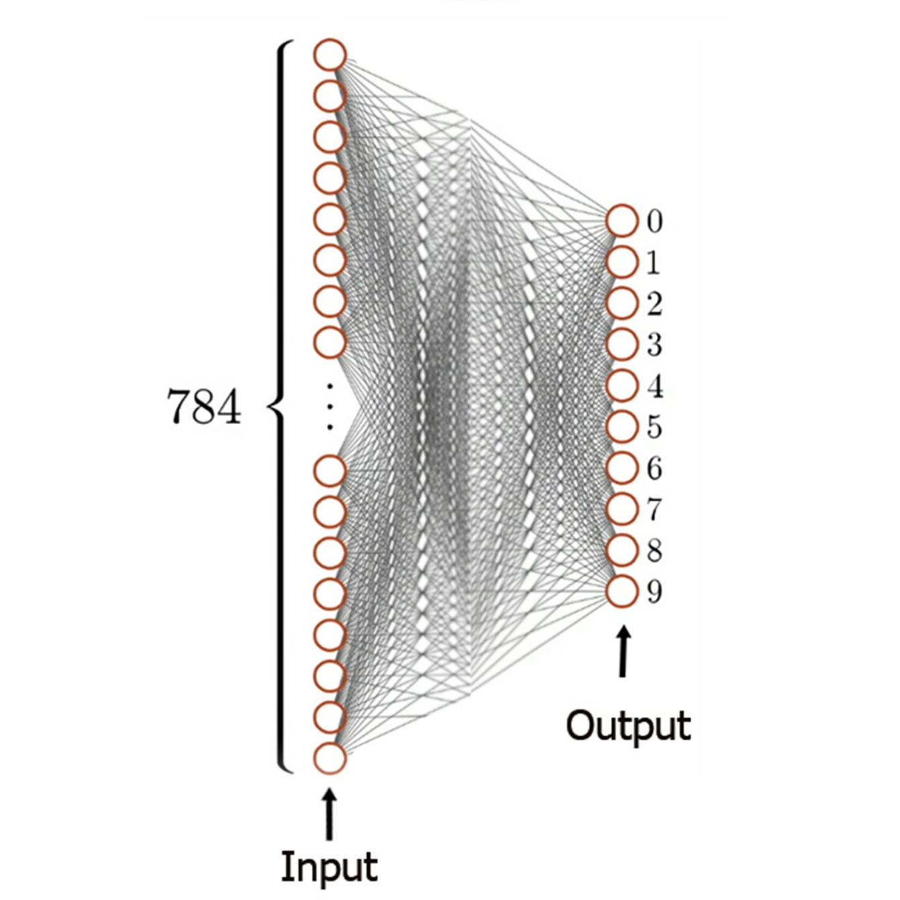
Neural network
Simple.
No hidden layers.
This linear (surprisingly).

Slide 4
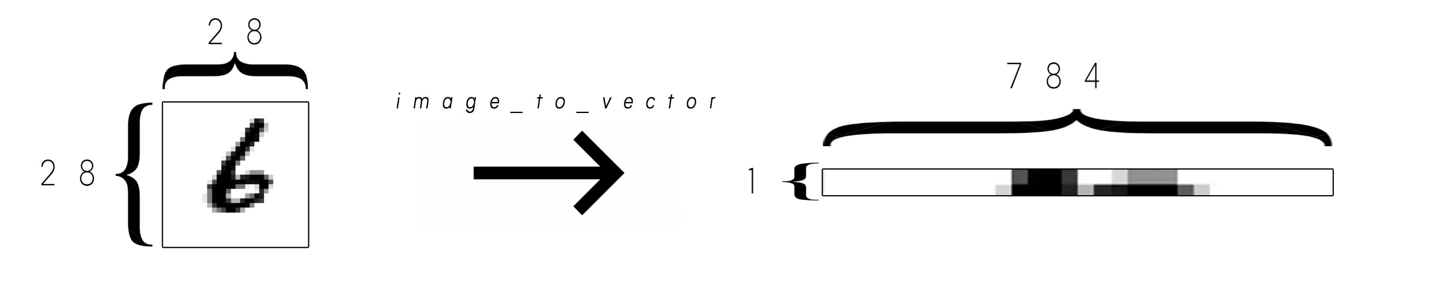
Our data (mnist images)

Slide 5
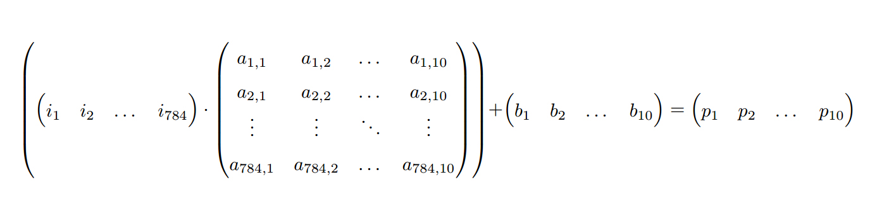
Matrix/vector operations 1

Slide 6
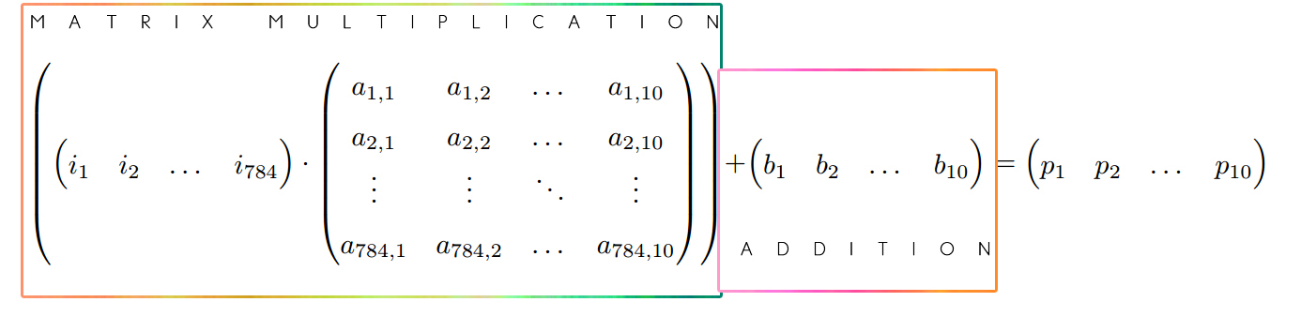
Matrix/vector operations 2

Slide 7
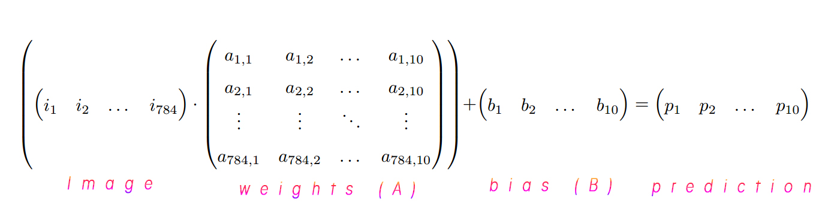
Matrix/vector operations 3

Slide 8
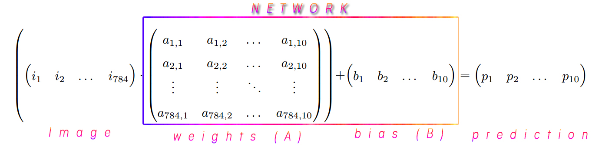
Matrix/vector operations 4

Slide 9
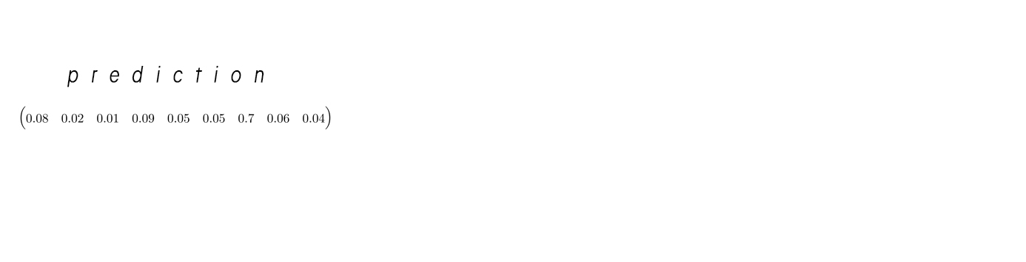
Predictions 1
Notes:
The prediction is a vector of probabilities that the NN assigns to each discrete outcome (digits 0-9).

Slide 10
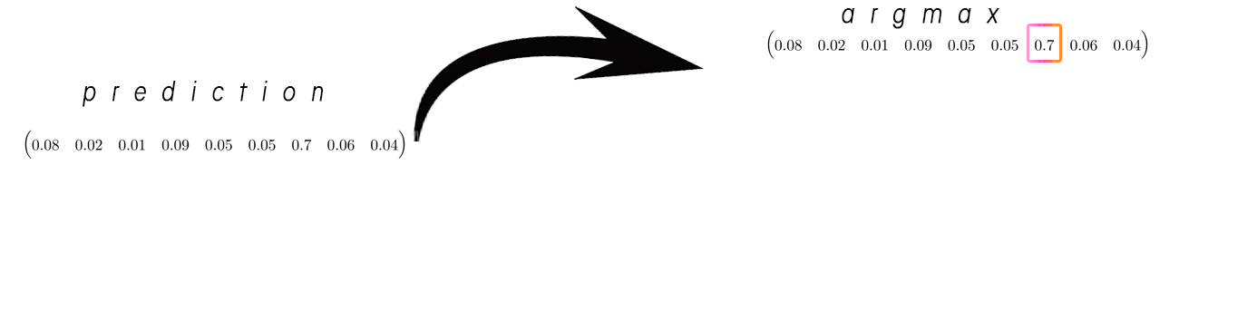
Predictions 2

Slide 11
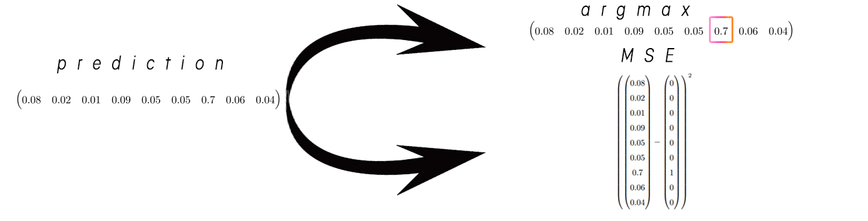
Predictions 3

Slide 12
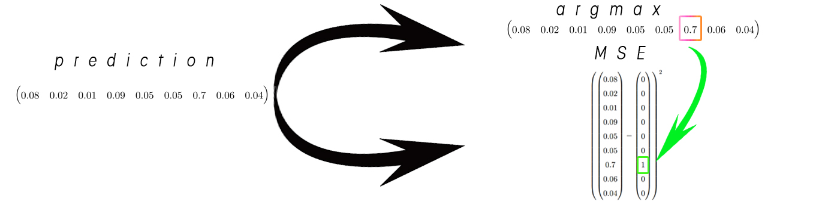
Predictions 4

Slide 13

Predictions 5

Slide 14
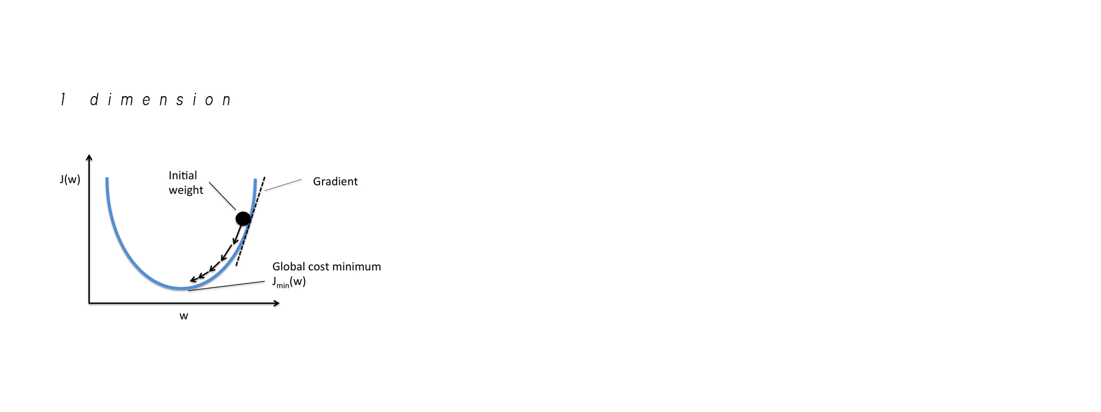
Gradient descent 1
Notes:
Differentiating MSE.
Stepsize (alpha).

Slide 15
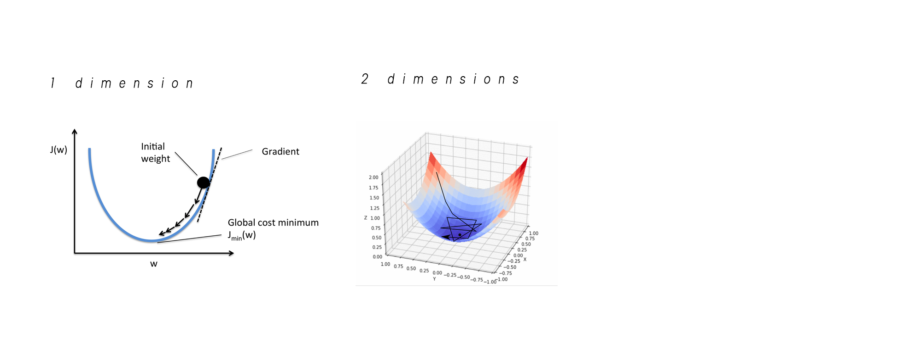
Gradient descent 2

Slide 16
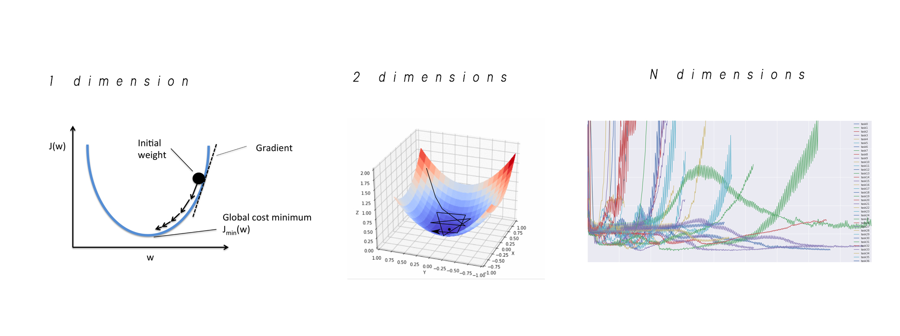
Gradient descent n

Slide 17
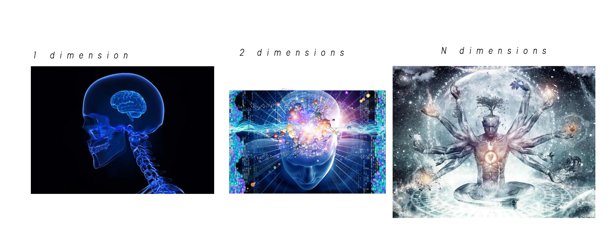
Gradient descent

Slide 18
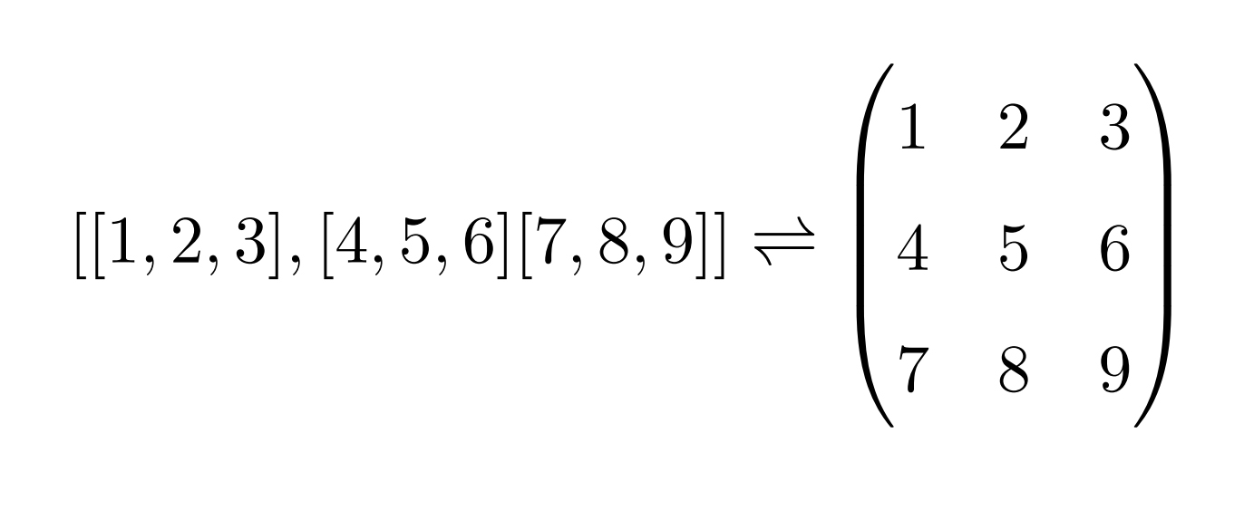
List of lists → vector/matrix

Slide 19
Insert Quote text, for next level ENTER and TAB
Insert Name

